Slide 1
API Automation
Challenge:
At beginning we used to get almost 2 to 3 builds every day and we don’t have an UI to test it. We used to test the APIs using rest clients. So whenever a build is released we used to test around 30 Min for no harm and around 1 hr for regression.
Solution Using SoapUI:
SoapUi is an open source tool which offers support to test Rest and Soap web service calls. We can create test suites, test cases and test steps for n number of projects.
This tool supports groovy scripting language. So along with groovy we were able to automate the APIs and generate reports using mail system. MySQL DB is used as test data maintenance tool.
Currently we are using the same script for running the test against Pre-DIT, DIT, FIT, IPE, IAT, UAT and PROD environments.
We have also integrated the test scripts with JENKINS so our developers are using this for baseline testing for build deployments.
This automation have reduced the testing from 1.30 hr(one environment) to 3 mins(Max. 7 mins).

Slide 2
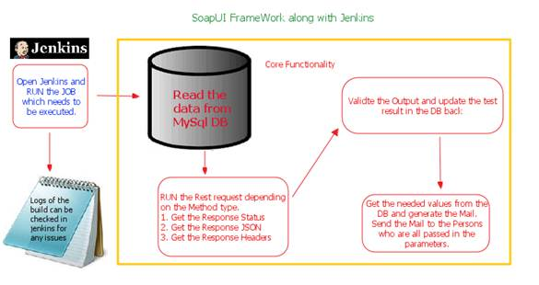
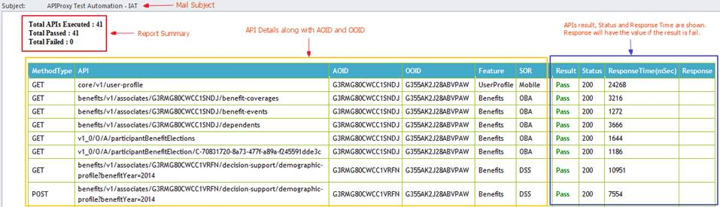
SoapUI Framework and Mail Reporting Sample

Slide 3
More Solutions and RoadMap
More Solutions:
Along with API Proxy we have API translator and API Gateway also automated using SoapUI tool.
API Translator:
It is a controller that is used inside API Proxy which supports in translating the APIs from OLD to NEW and vice versa.
Here we started validating the response JSON using groovy scripts and reporting the output.
API GateWay:
API GateWay uses auth2.0 client grant type calls. The normal rest client extensions does not support auth2.0 calls.
So with the help of developers we imported the cert into soapUI and started automating it.
RoadMap:
Integrating API Gateway test with Jenkins.
Search APIs Automation.
Extending the APIT for regression testing.

